Slide 1
Bootcamp – part 2
Emanuele Della Valle
Prof. @ Politecnico di Milano
Founder & Partner @ Quantia Consulting
Marco Balduini
Founder & CEO @ Quantia Consulting
Riccardo Tommasini
Prof. @ INSA Lyon (France)

Slide 2
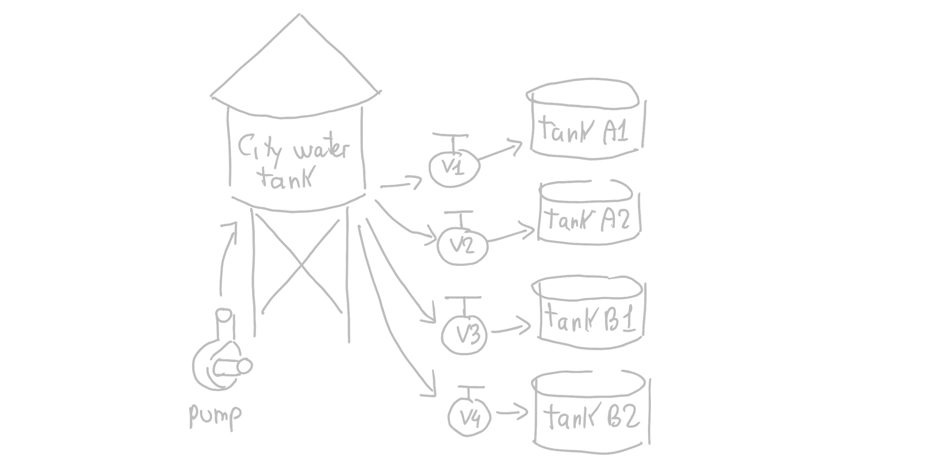
Recall the Demo Scenario

Slide 3
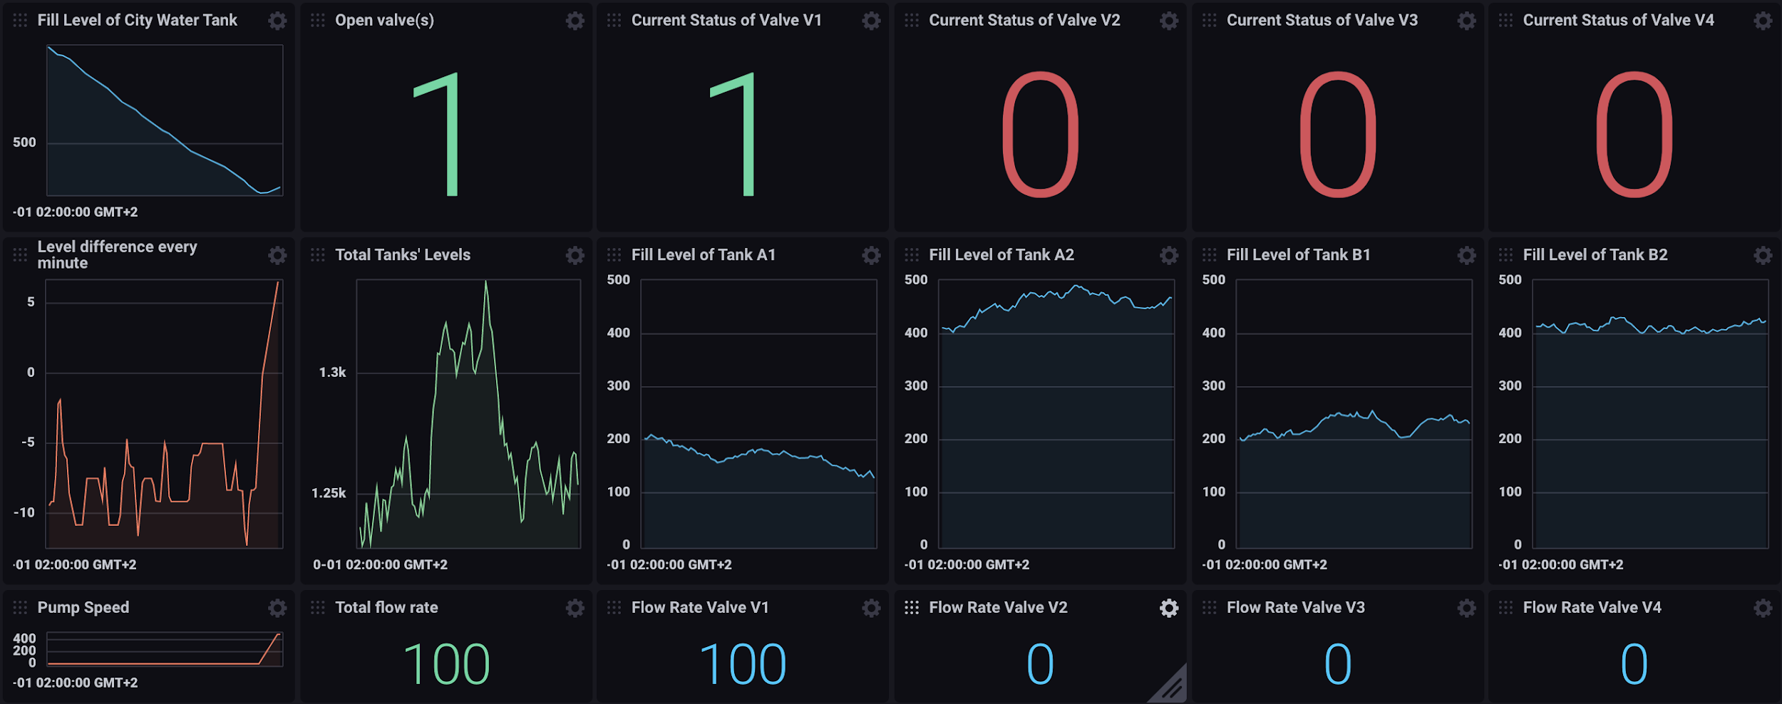
Recall the Dashboard we demoed

Slide 4

Let’s go to the boot camp
BC2

Slide 5
It’s again your turn!

Slide 6
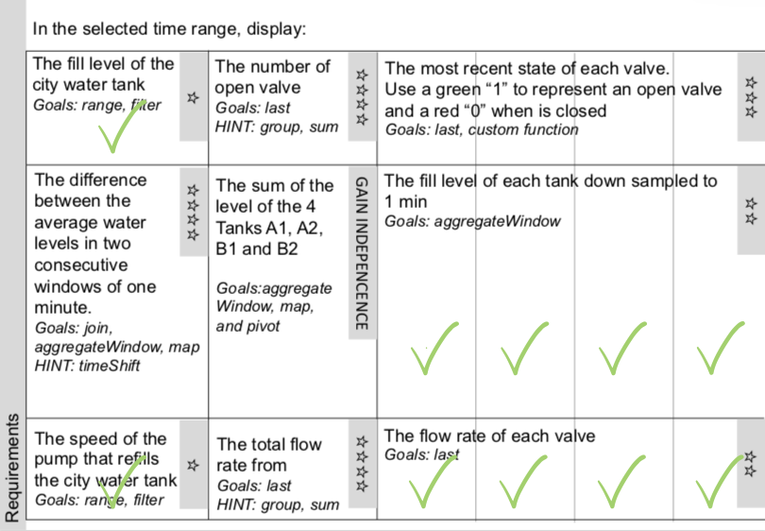
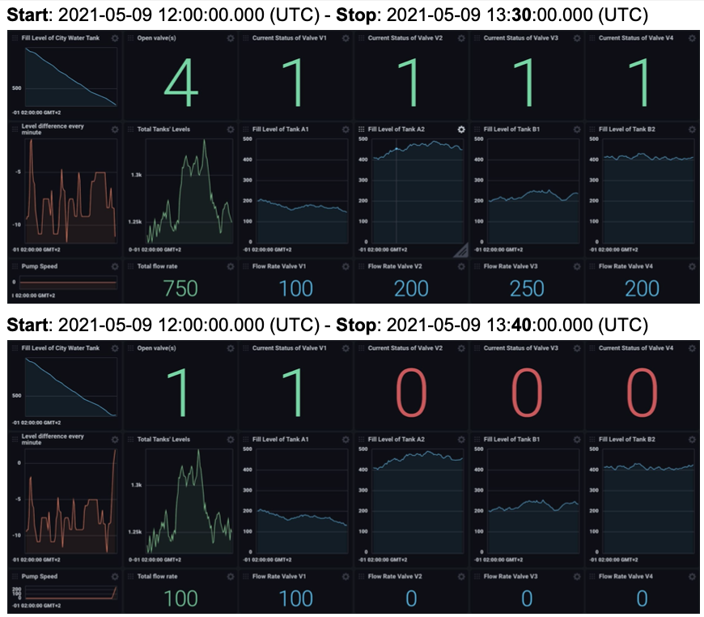
Check out the new material we are sharing with you
Requirements
Test cases

Slide 7

WARNING: it’s time to gain independence!

Slide 8
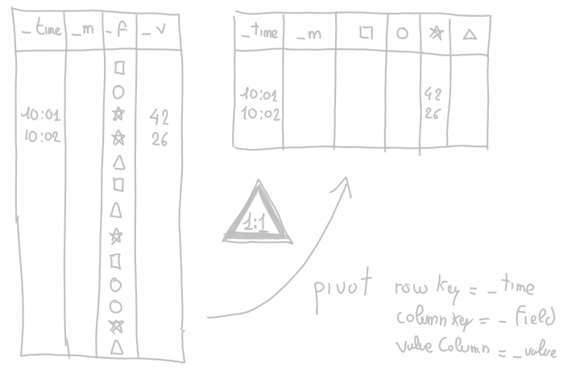
Pivoting narrow data in wide data!
https://v2.docs.influxdata.com/v2.0/reference/flux/stdlib/built-in/transformations/pivot/

Slide 9
Bootcamp – part 2
Emanuele Della Valle
Prof. @ Politecnico di Milano
Founder & Partner @ Quantia Consulting
Marco Balduini
Founder & CEO @ Quantia Consulting
Riccardo Tommasini
Prof. @ INSA Lyon (France)

